Slide 1
EESTEC challenge 2022
Team: DEEP ENOUGH
EESTEC Challenge2022 | DeepEnough
2022

Slide 2
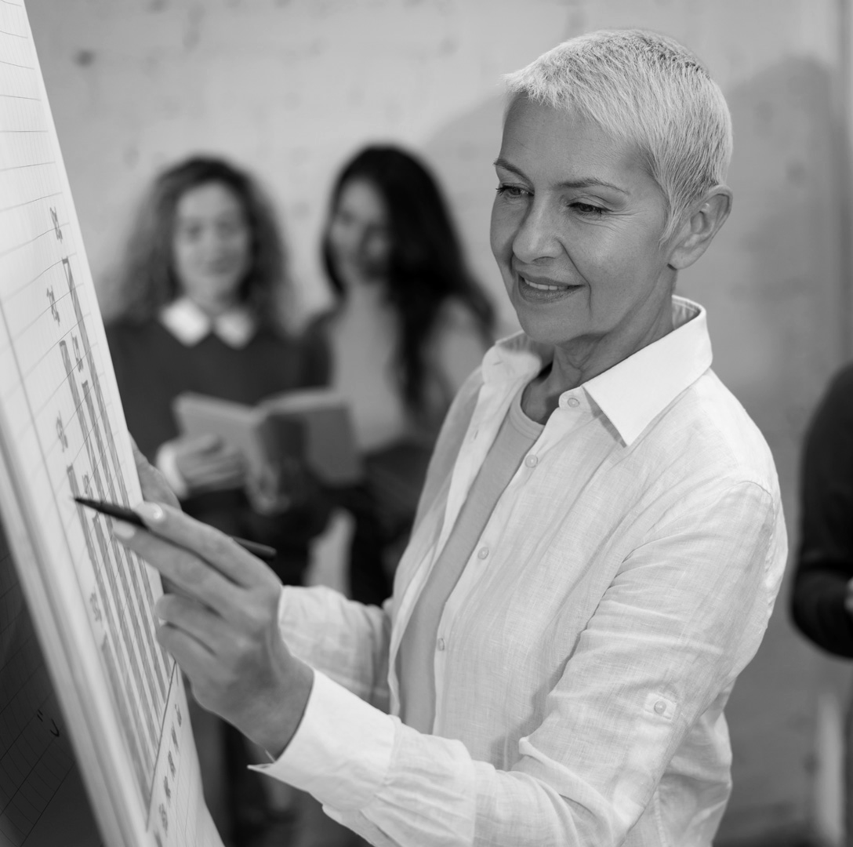
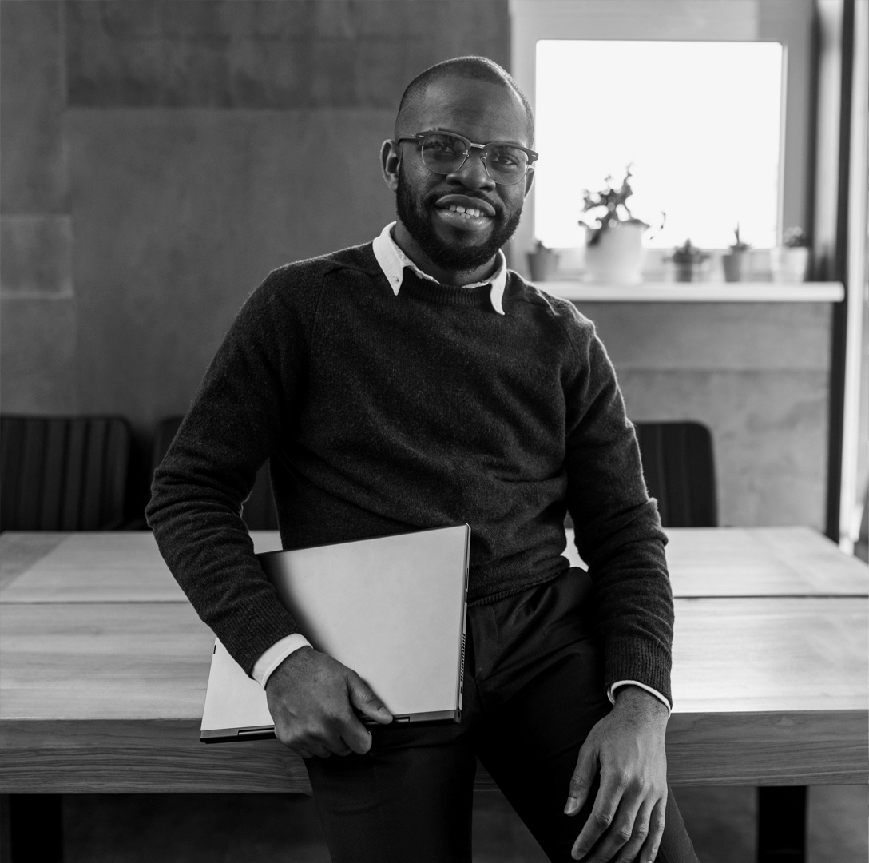
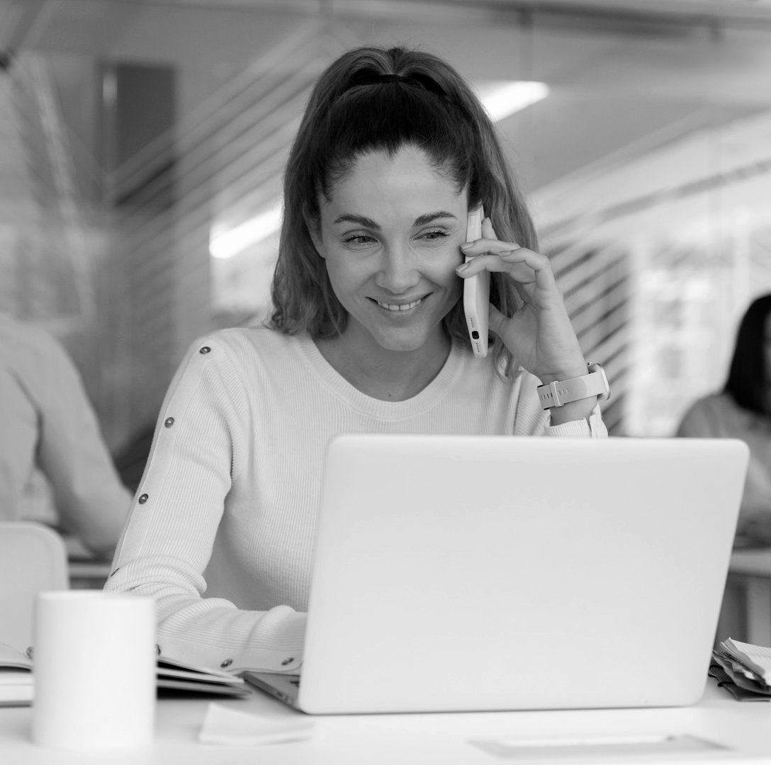
Our team
Juan Calderon
Irene Rigato
Robert Stefano Chinga
Computer Science Engineering Student
Biomedical Engineering Student
Computer Science Engineering Student
EESTEC Challenge2022 | DeepEnough
2022

Slide 3
Table of contents
01
02
03
Data collection & Preprocessing
Model
Test and Predictions
04
Demo
EESTEC Challenge2022 | DeepEnough
2022

Slide 4
01
Data collection & Preprocessing
EESTEC Challenge2022 | DeepEnough
2022

Slide 5

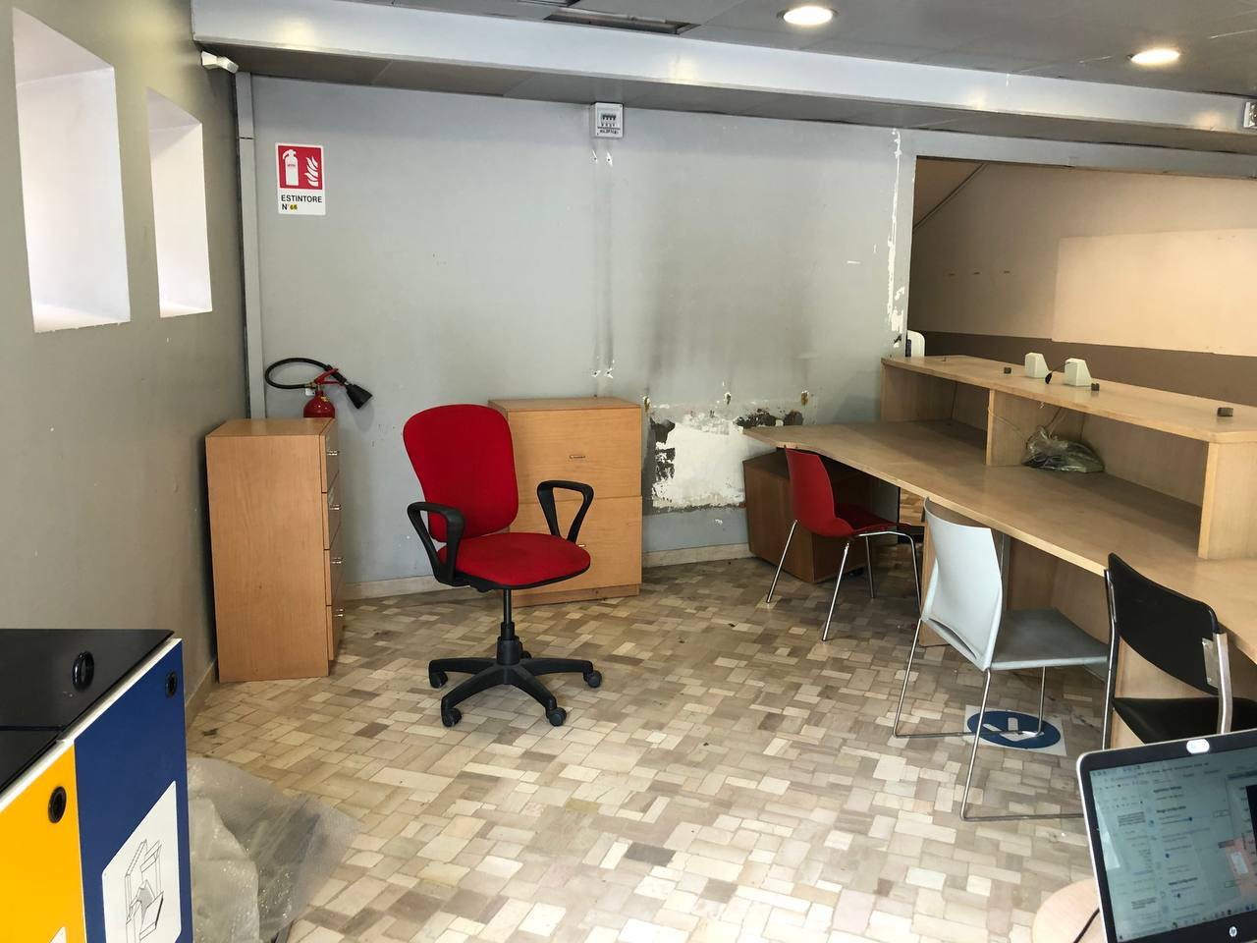
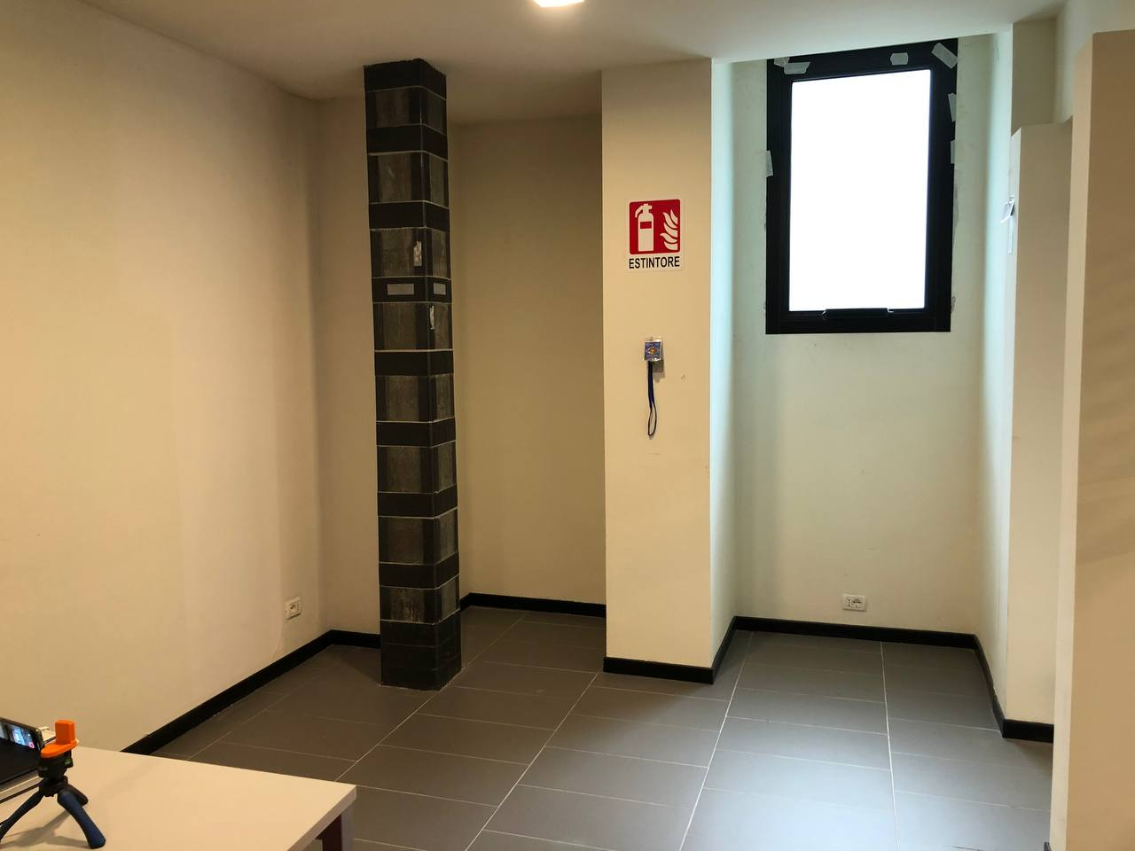
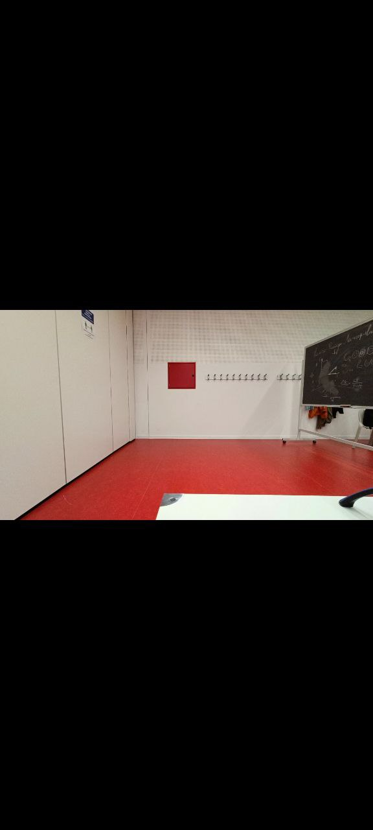
Environment 1
Environment 2
Environment 3
EESTEC Challenge2022 | DeepEnough
2022

Slide 6

Preprocessing
Preprocessing_rangeDopplerData
Already balanced dataset
Preprocessing
Raw Data
Transformation into image
To obtain better CNN’s model performances
Product vision | Pitch deck
2022

Slide 7
02
Model
EESTEC Challenge2022 | DeepEnough
2022

Slide 8

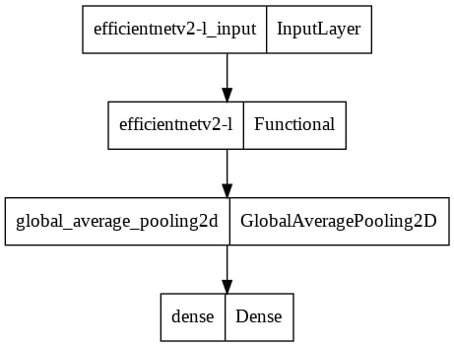
EfficientNetV2L
Parameters:
EESTEC Challenge2022 | DeepEnough
2022

Slide 9
03
Test and Predictions
EESTEC Challenge2022 | DeepEnough
2022

Slide 10
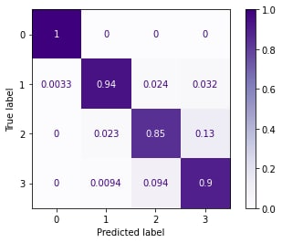
Model testing on the previous environments
EESTEC Challenge2022 | DeepEnough
2022

Slide 11
Awesome words
Product vision | Pitch deck
2022

